Slide 1
Programming the AR drone

Slide 2
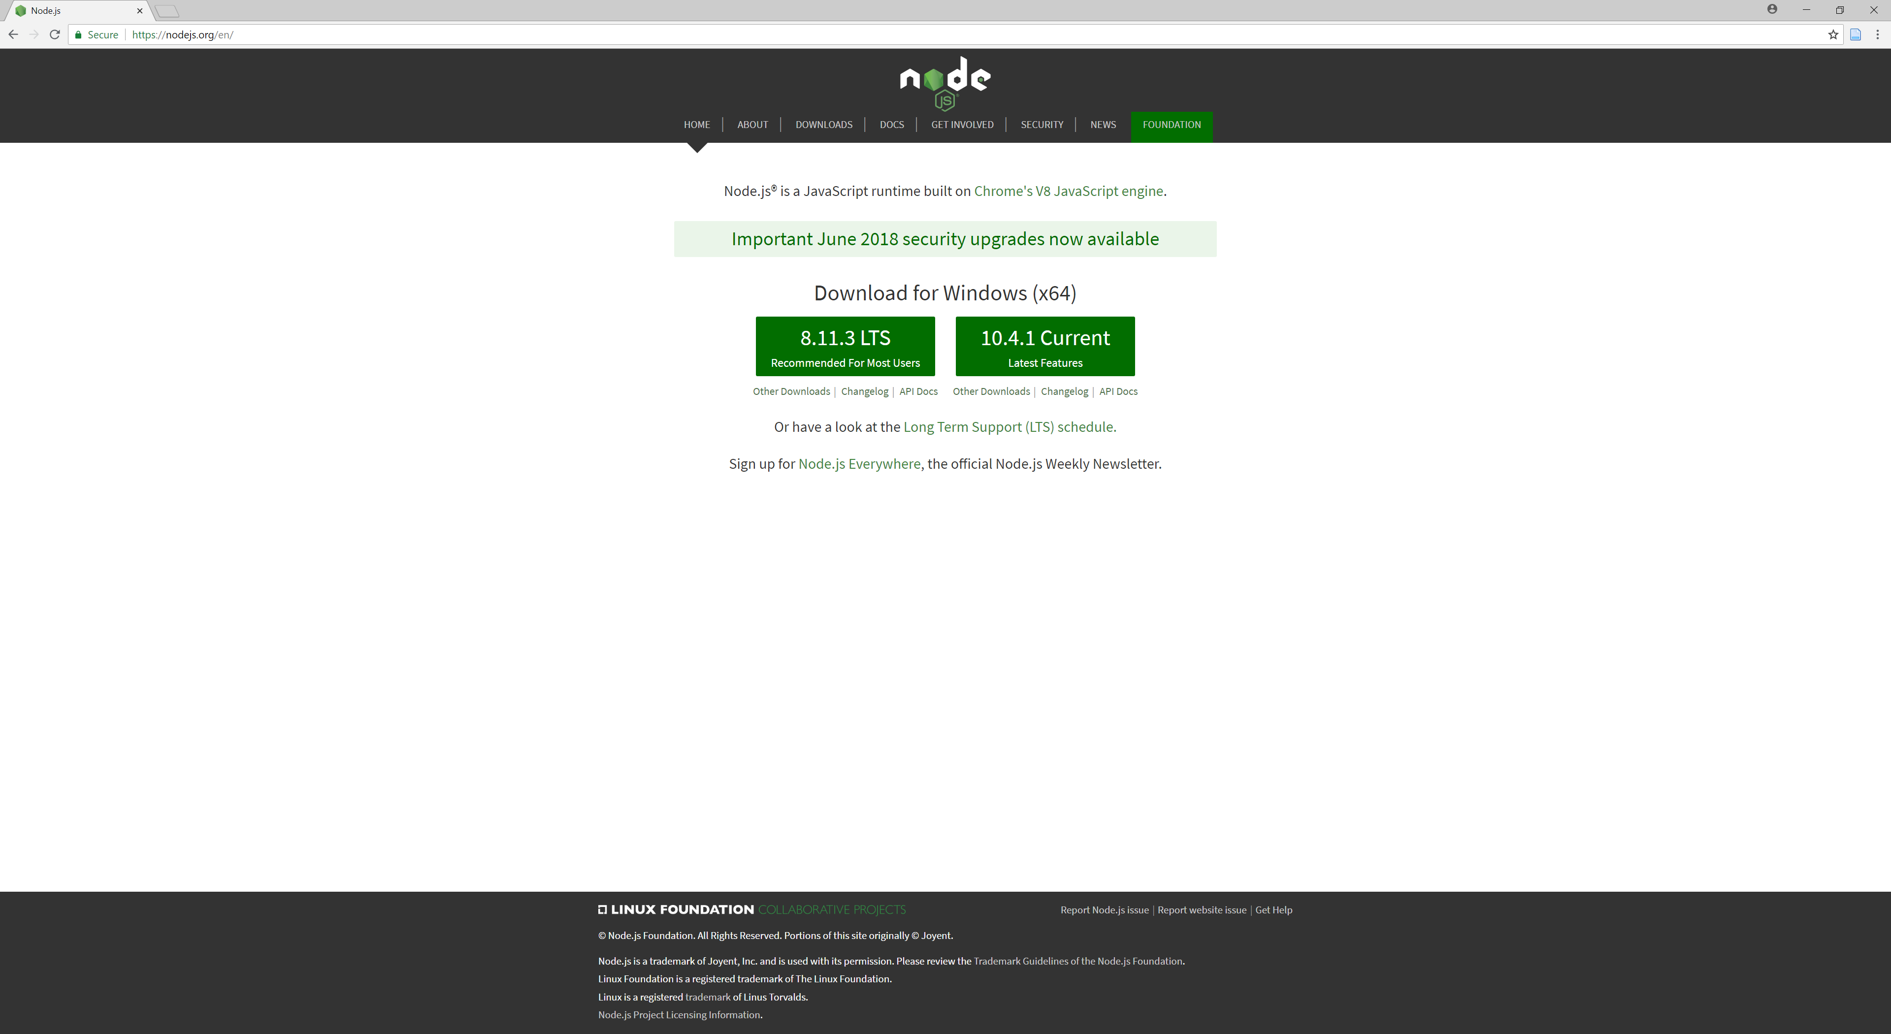
Installing node

Slide 3
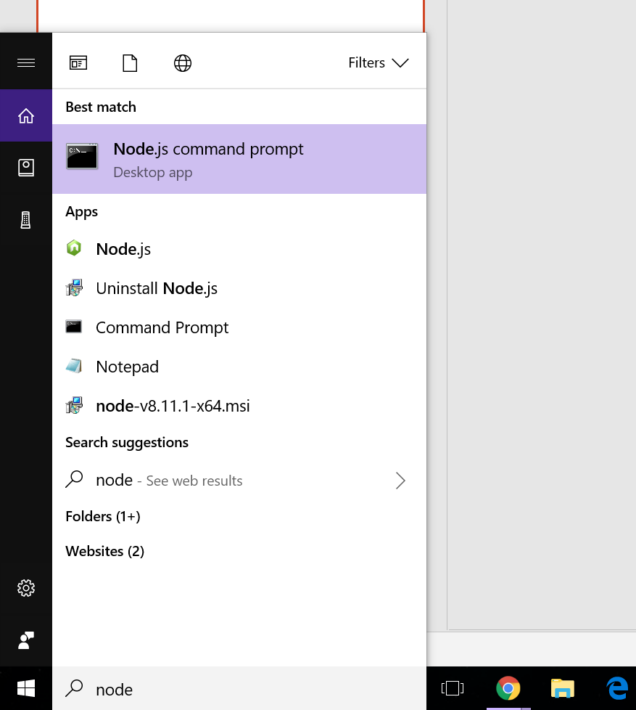
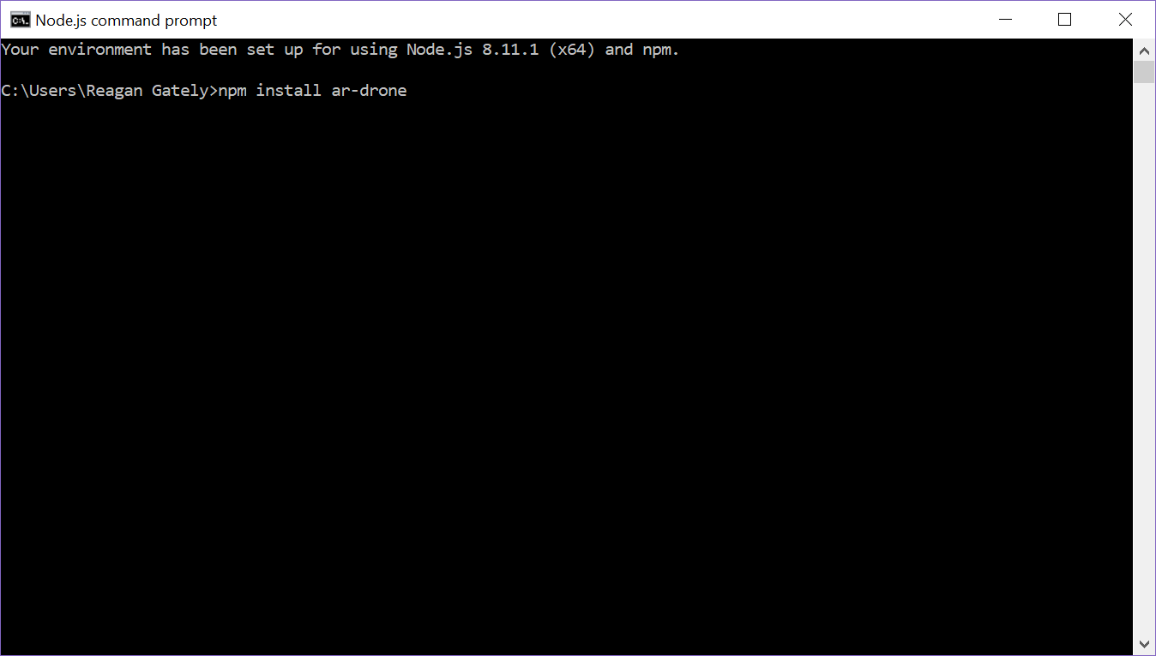
Installing the ar-drone module

Slide 4
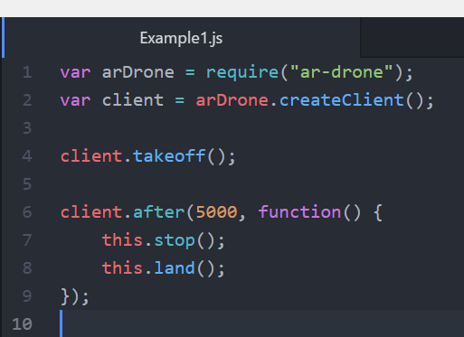
Hello world
Open a text editor of your choice and write the following code.
Note: Make sure you save the file with the .js file extension

Slide 5
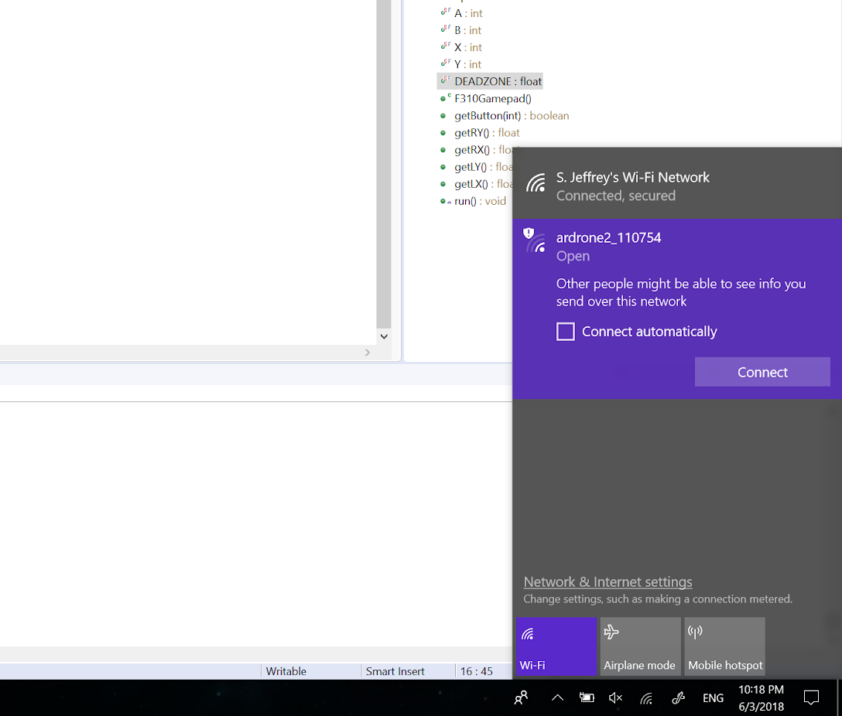
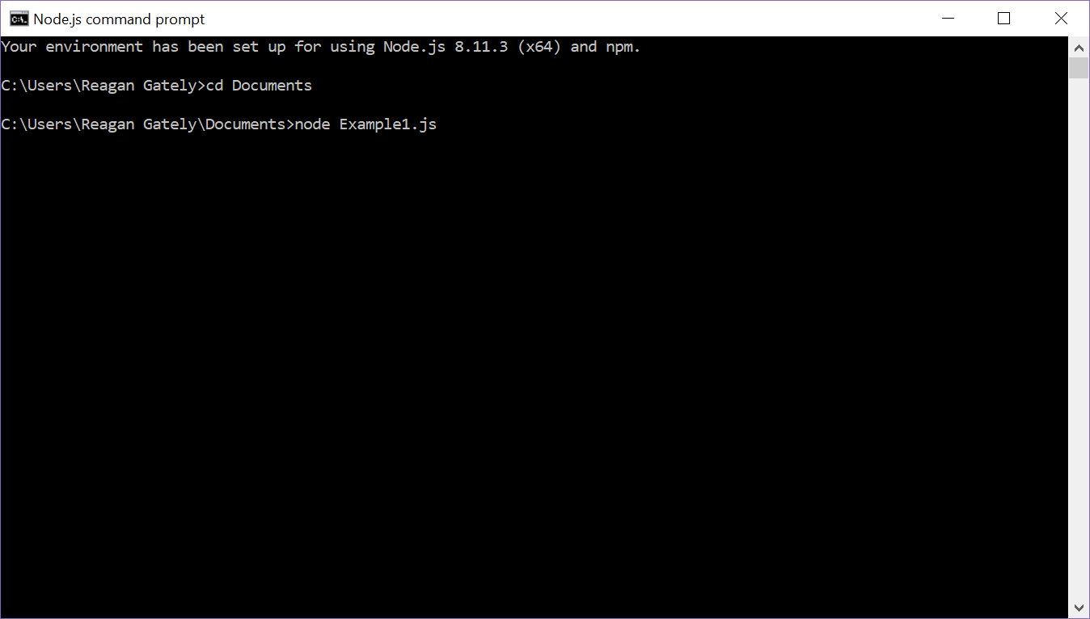
Running the program
1. Connect to the drone 2. Run the program in command prompt

Slide 6
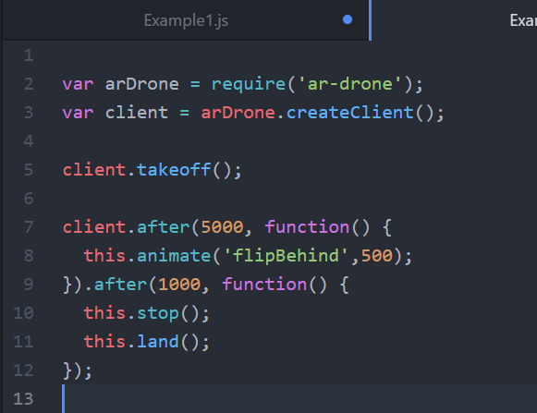
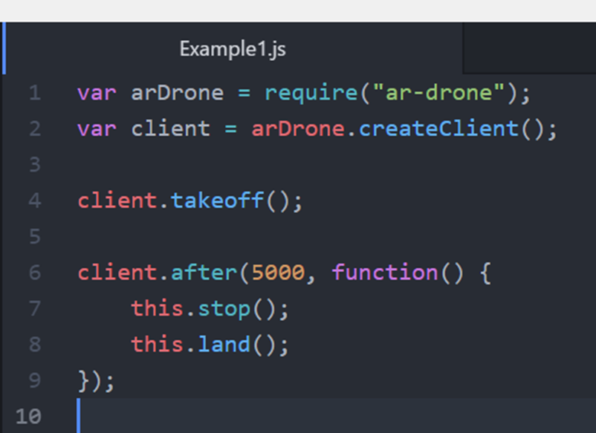
Explanation
The “require()” function loads the
ar-drone module
The “takeoff()” tells the drone to begin the takeoff sequence
The “after()” function allows us to
Execute a callback function after a defined period of time

Slide 7

Explanation
The “this” keyword refers to the client object
The “stop()” function tells the drone to stop all movement and hover
The “land()” function initiates the drone’s landing sequence

Slide 8
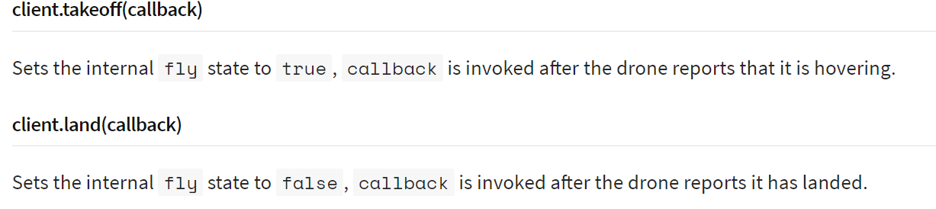
A look at some basic library functions

Slide 9
A look at some basic library functions
client.takeoff(callback) tells the drone to initiate its takeoff sequence. After a successful takeoff, the callback function will be called.
Likewise, the client.land(callback) invokes the drone’s landing sequence. The callback function will be called when the drone has successfully landed.

Slide 10
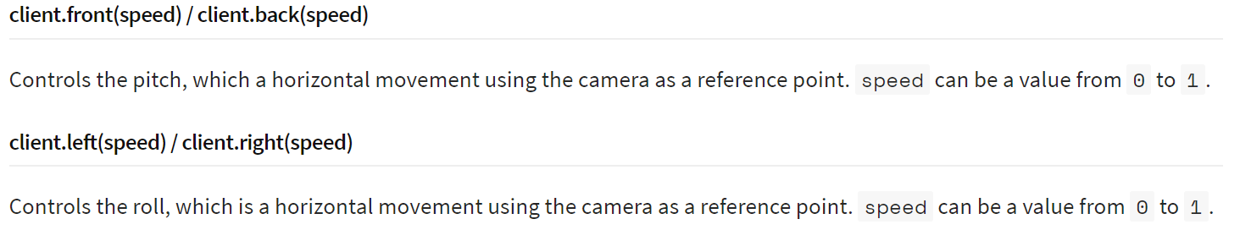
A look at some basic library functions

Slide 11
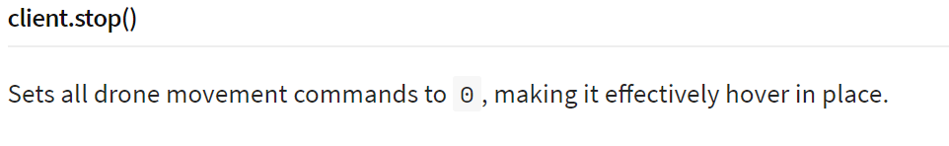
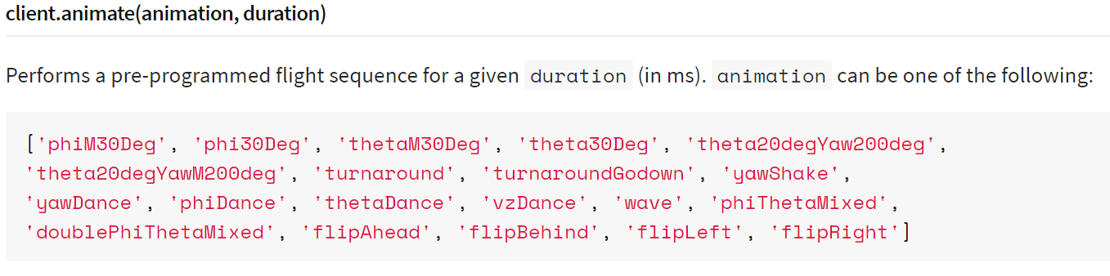
A look at some basic library functions

Slide 12
Challenge: Make the drone do a backflip
Using the functions that we have learned, try to design a program that makes the drone takeoff, flip backwards, and land. If you need to review the functions, Navigate to https://www.npmjs.com/package/ar-drone to view the documentation.

Slide 13
Example code

Slide 14
What is really happening when we are programming the drone?
In reality, we are not writing code that will run on the drone hardware. Rather, we are writing a program that runs on the computer and sends pre-defined commands to the drone via wifi.

Slide 15
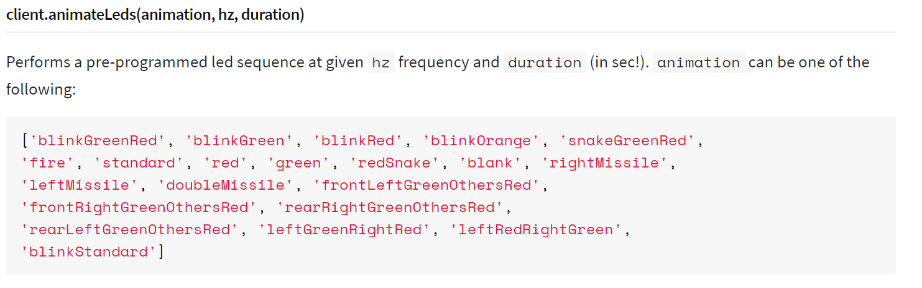
Controlling the Drone LEDs

Slide 16
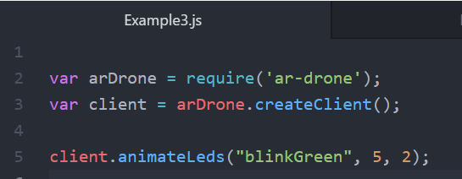
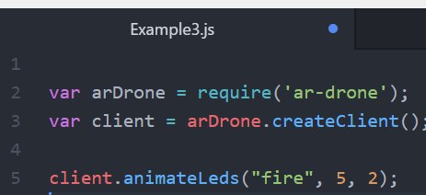
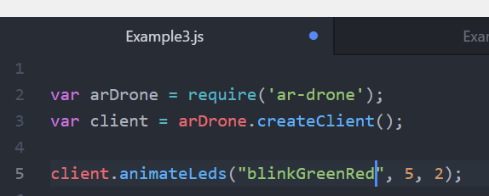
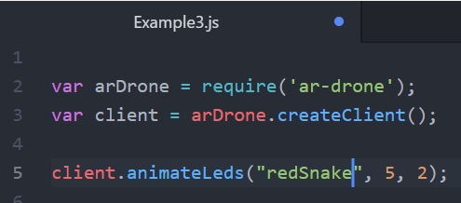
Controlling the Drone LEDs

